Slide 1
Using LLMs
https://github.com/semmi88/teaching

Slide 2
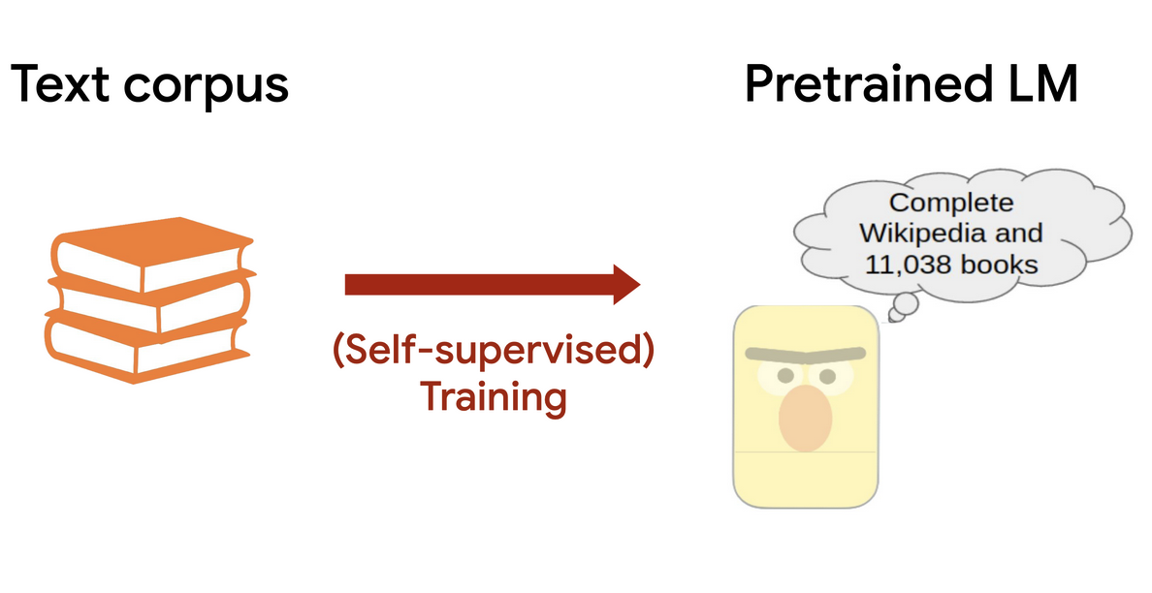
Large Language Models

Slide 3
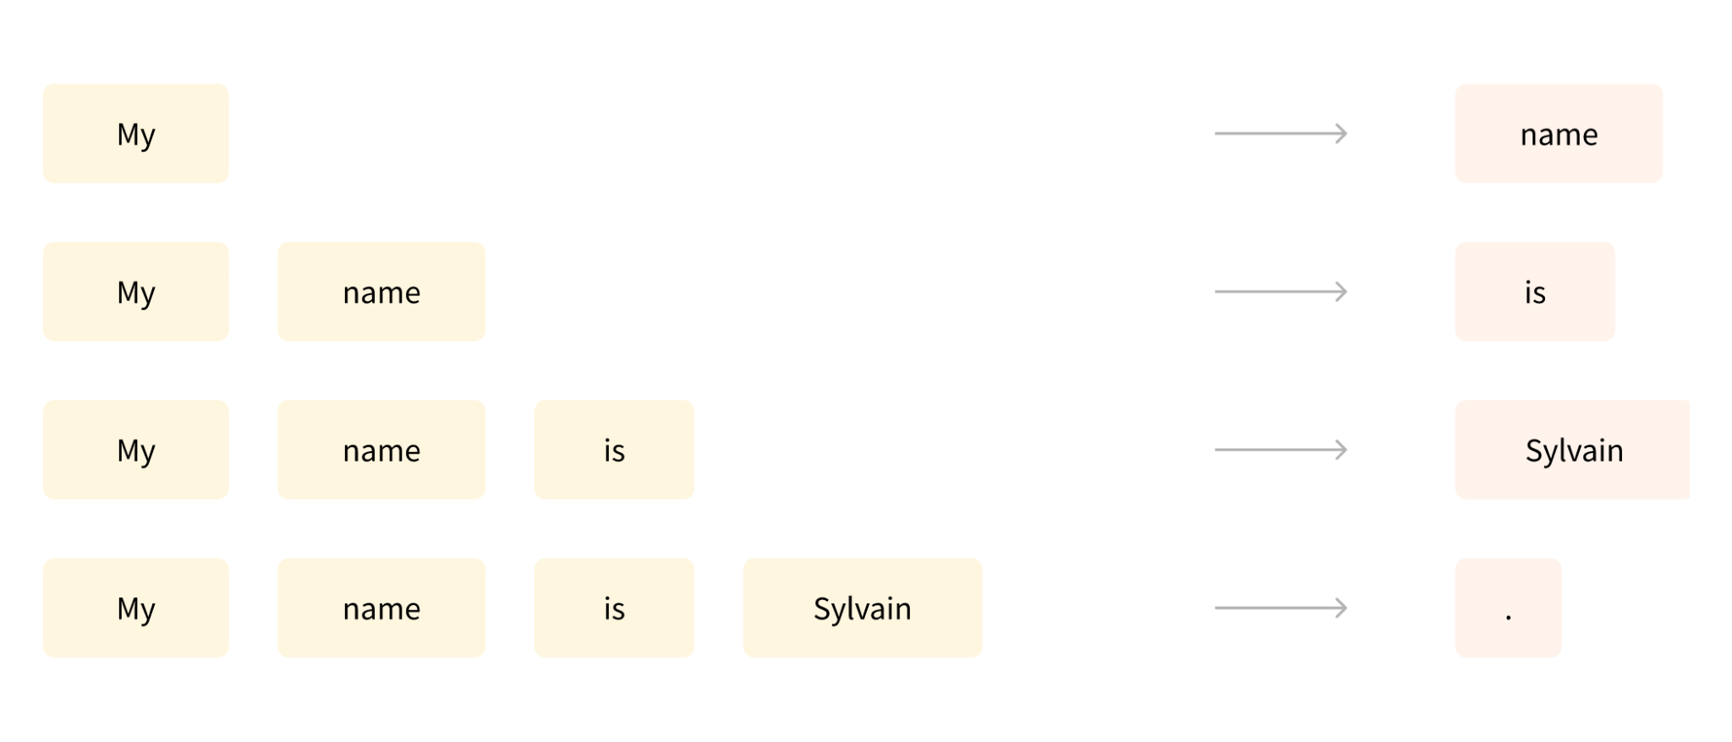
Casual Language Modeling
Predict the next word

Slide 4
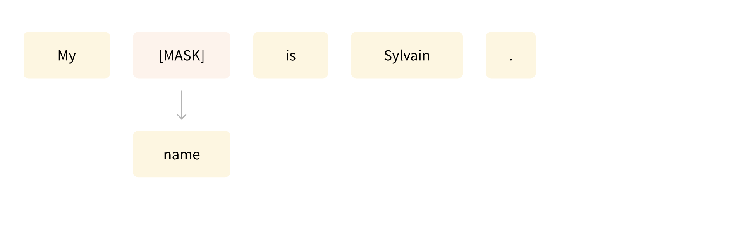
Masked Language Modeling
Predict missing words

Slide 5
Casual vs Masked
Attention only looks backwards
Next work prediction
Decoder based, auto-regressive
Best for: text generation
GPT
Bi-directional attention
Reconstructing sentences
Encoder based, auto-encoder
Best for: classification, extraction
BERT

Slide 6
G
P
T

Slide 7
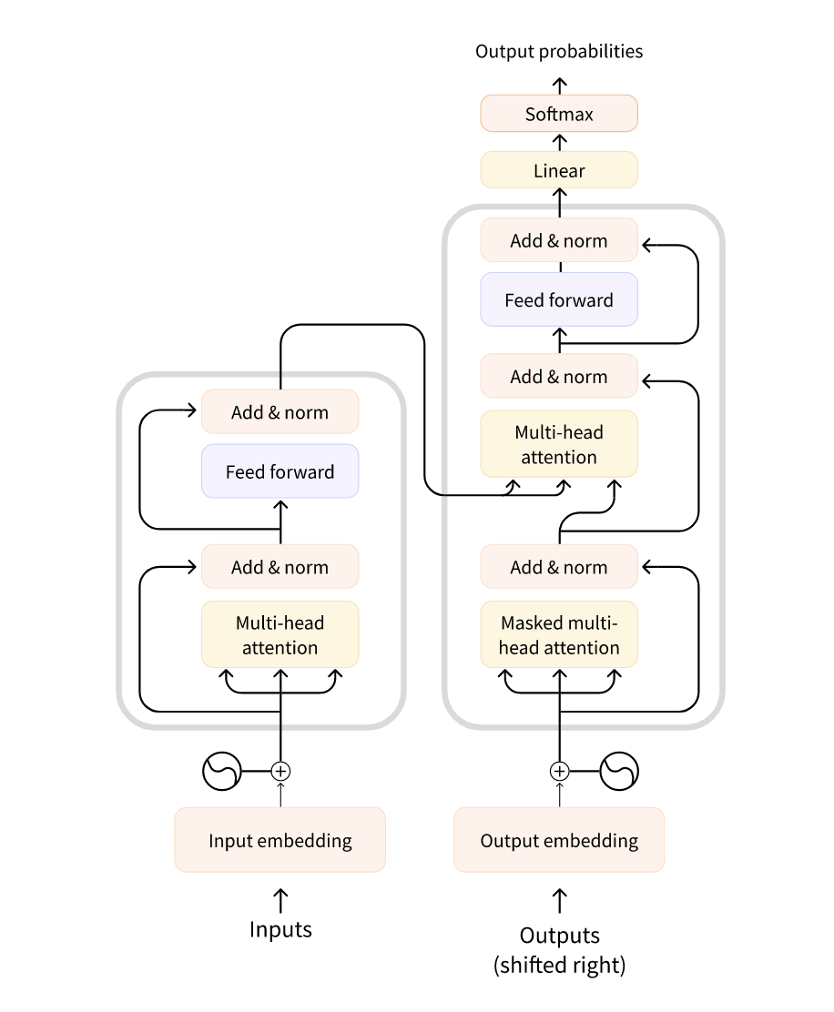
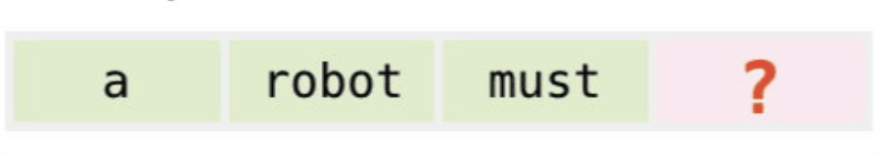
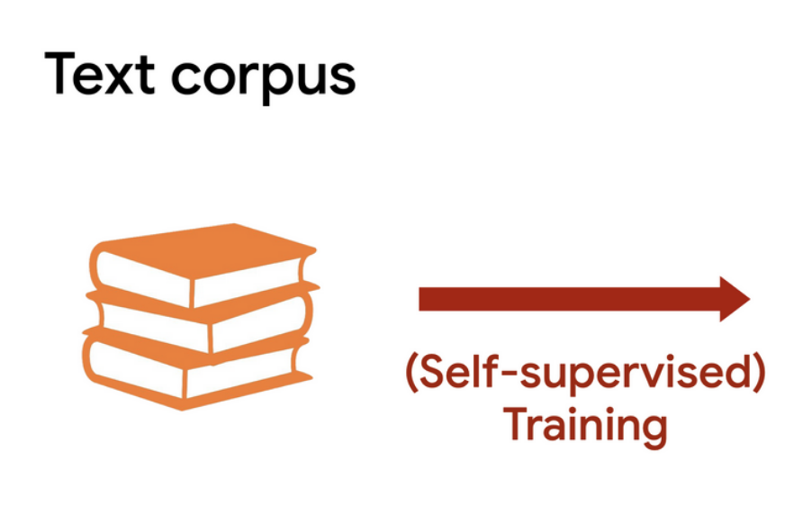
G
P
T
generative
pre-trained
transformer

Slide 8
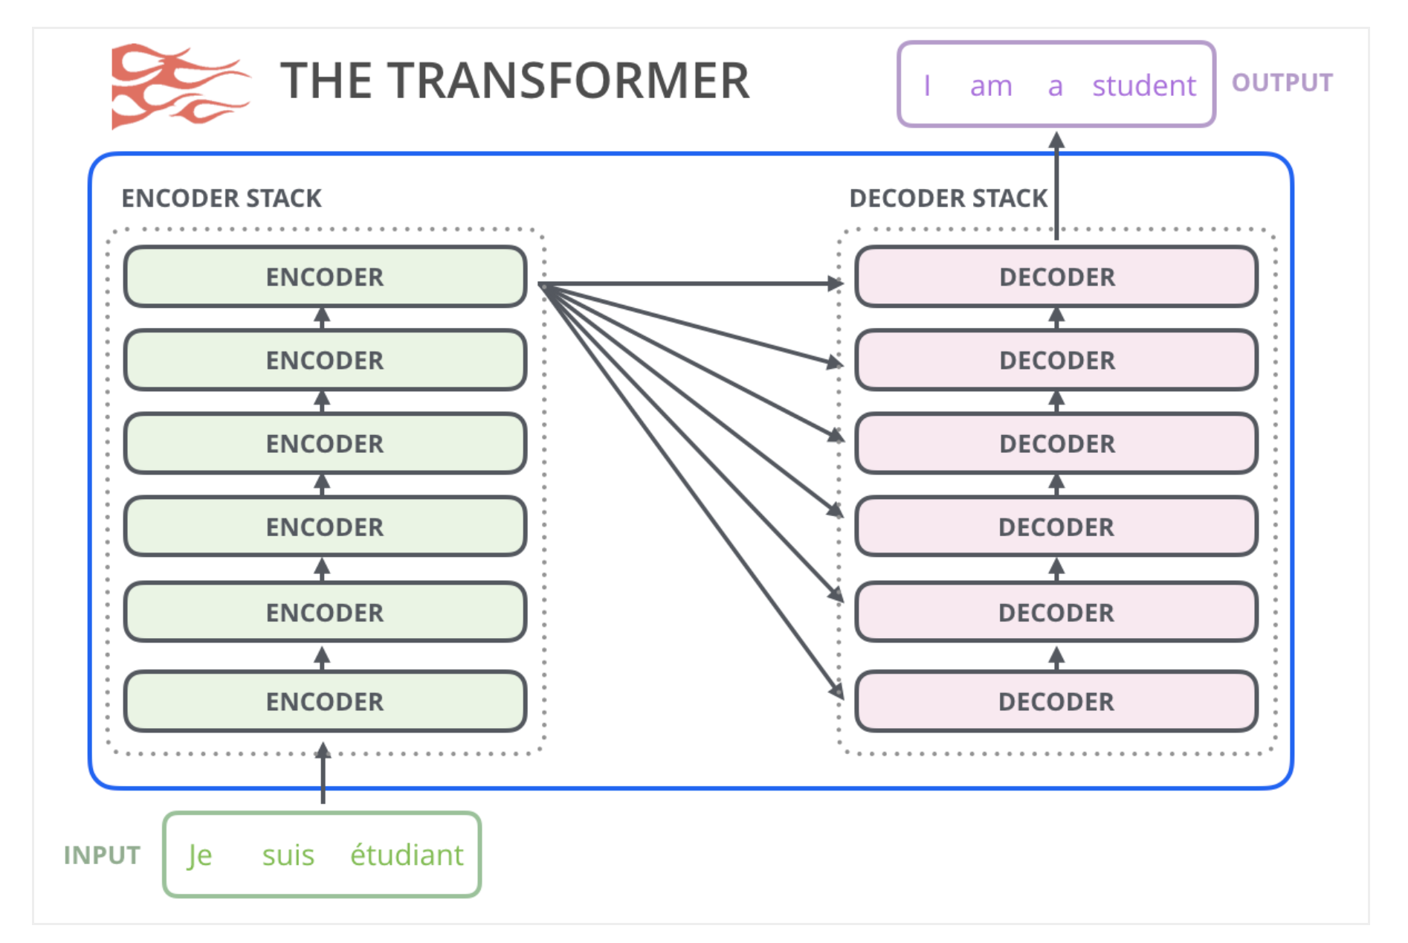
Transformers
Encoder / Decoder

Slide 9
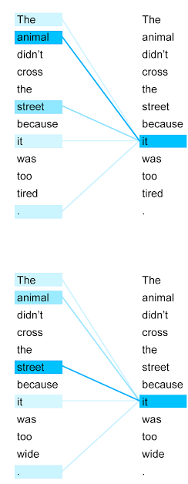
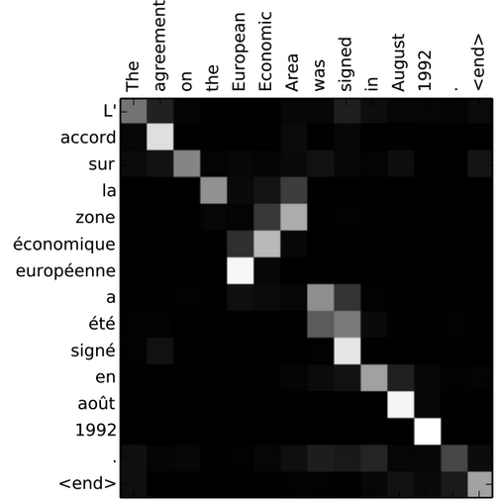
Transformers
Attention - multi-headed, self attention

Slide 10
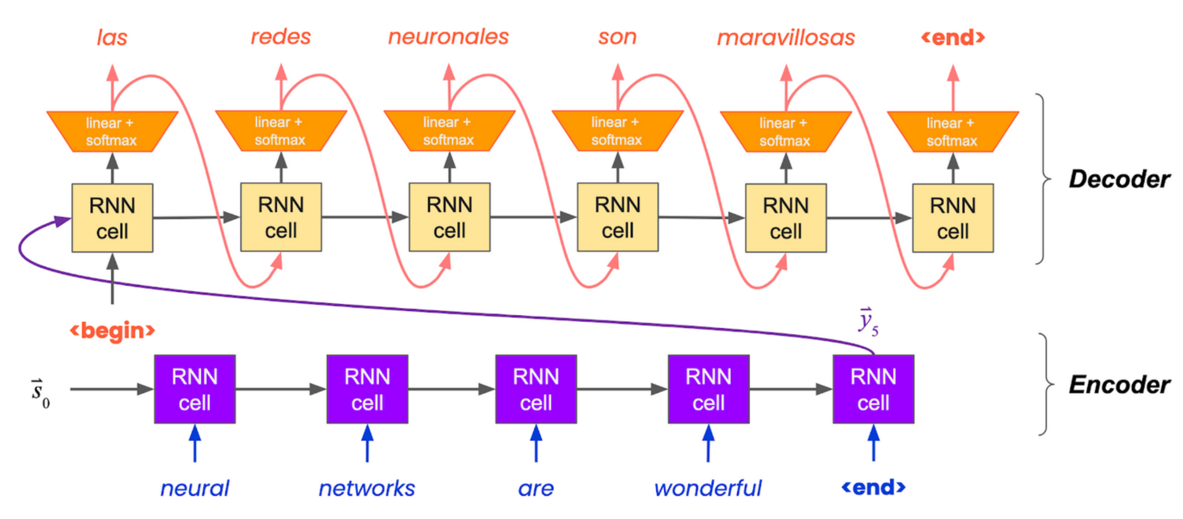
Transformers
Positional encoding

Slide 11
Transformers
Positional encoding

Slide 12
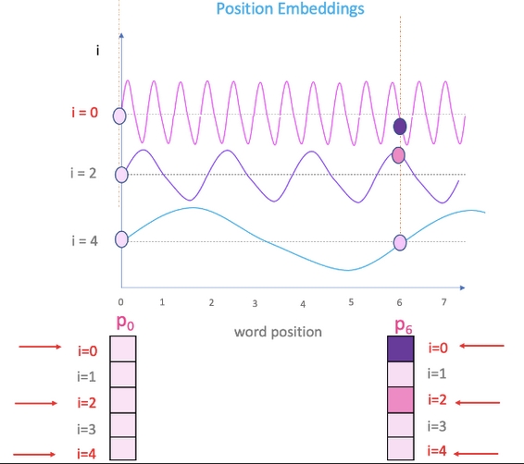
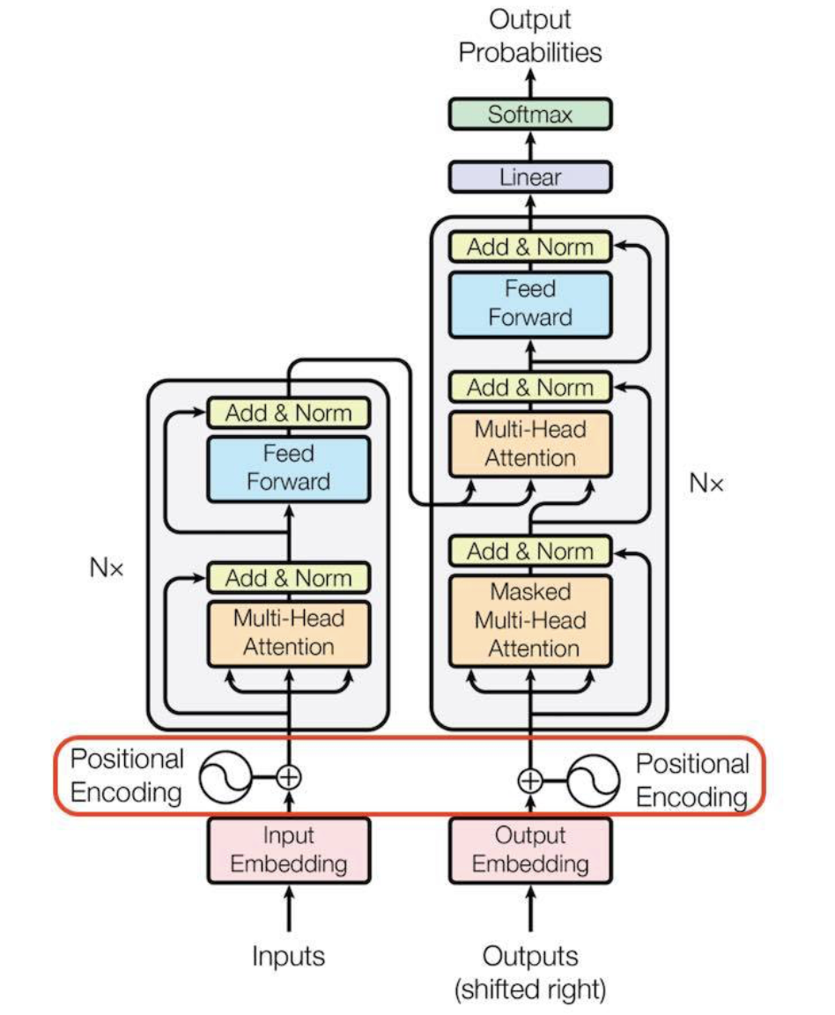
Transformers
Positional encoding

Slide 13
Transformers
Encoder / Decoder
Attention - multi-headed, self attention
Positional encoding

Slide 14
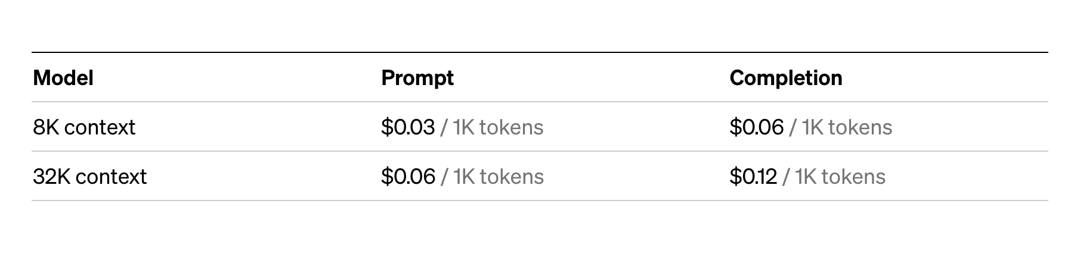
OpenAI - GPT4 API pricing

Slide 15
What is a token?
the unit of meaning in a text
in NLP we have texts, which need to be broken up into smaller unit that can be analyzed and process (tokenization)
What is a token for a human?

Slide 16

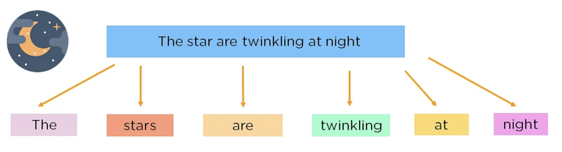
Tokenization
Word-based
vocabulary → IDs
+1 UNKNOWN category

Slide 17
Tokenization - Word based
Computationally expensive
There are too many words - 100.000 most common English
Transformer use attention mechanism → squared 10^10 sized matrices
Information loss
We will have many unknown words - information loss
dog vs dogs or run vs running - will be different IDs, relationship has to be relearnt

Slide 18
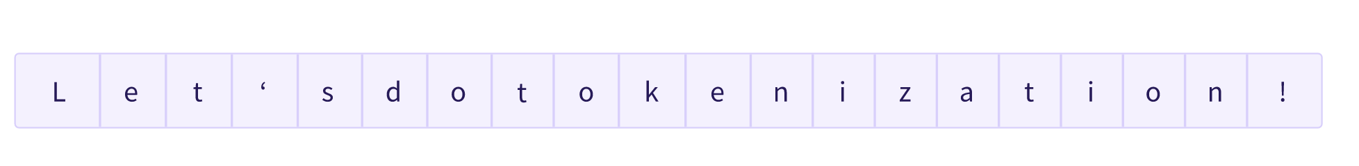
Tokenization - Character based
Assign ID to each character
Small vocabulary <100, no unknown words

Slide 19
Tokenization - Character based
Information loss
Valid words have (linguistic information) have to be relearnt, more data and training time is needed
Space inefficient, small context
Having an input of 100 tokens, only allows us a few sentences

Slide 20
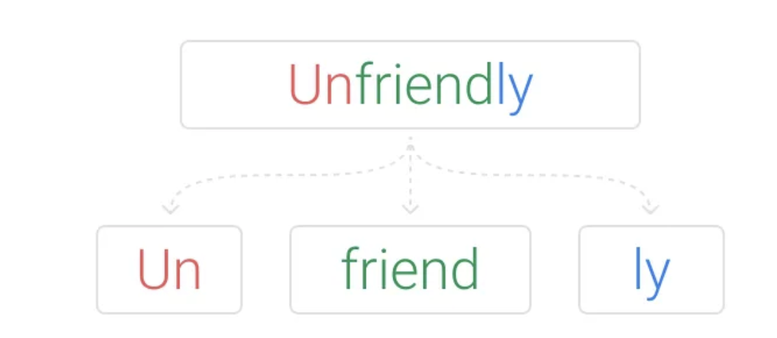
Tokenization - Subword
Preserve semantic meaning
frequent words are preserved
common suffixes/prefixes are preserved
Still space efficient
only use a couple of tokens for each word (and rarer words use more)

Slide 21
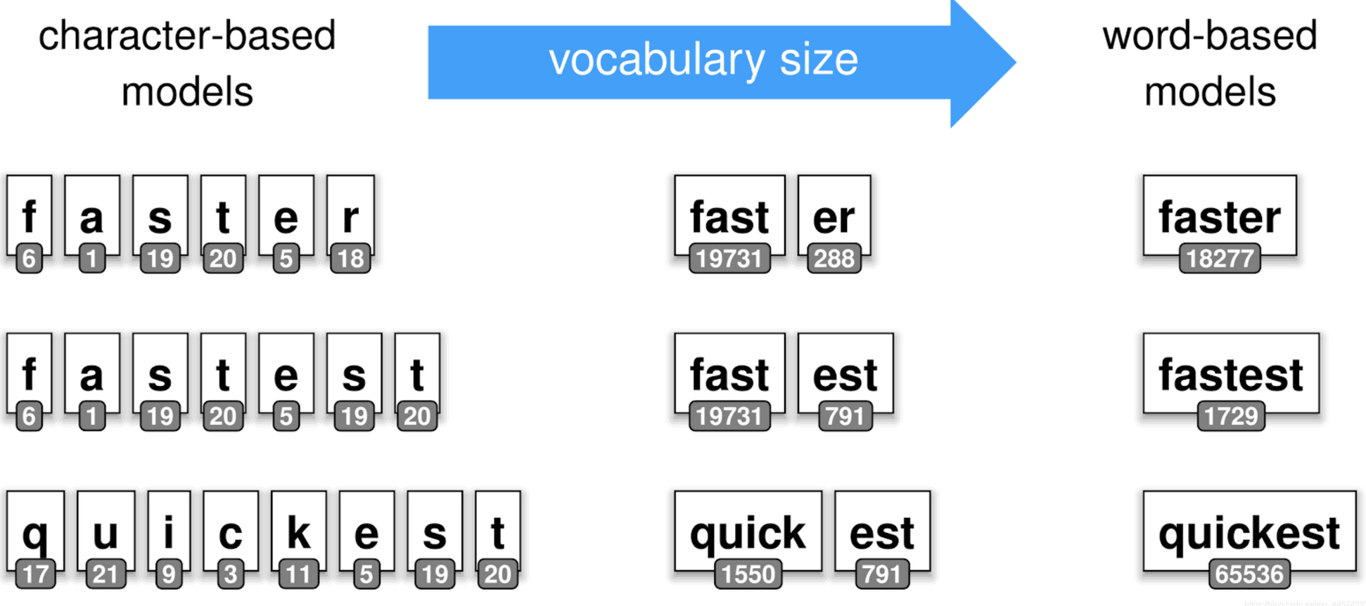
Tokenization

Slide 22
Byte Pair Encoding
Calculated based on text character statistics
Start with a vocabulary only containing characters
Search for most frequent pair of existing tokens (merge)
Add to vocabulary until a given size is reached

Slide 23
GPT-3 Tokenizer
Token → ID number (→ embedding)

Slide 24
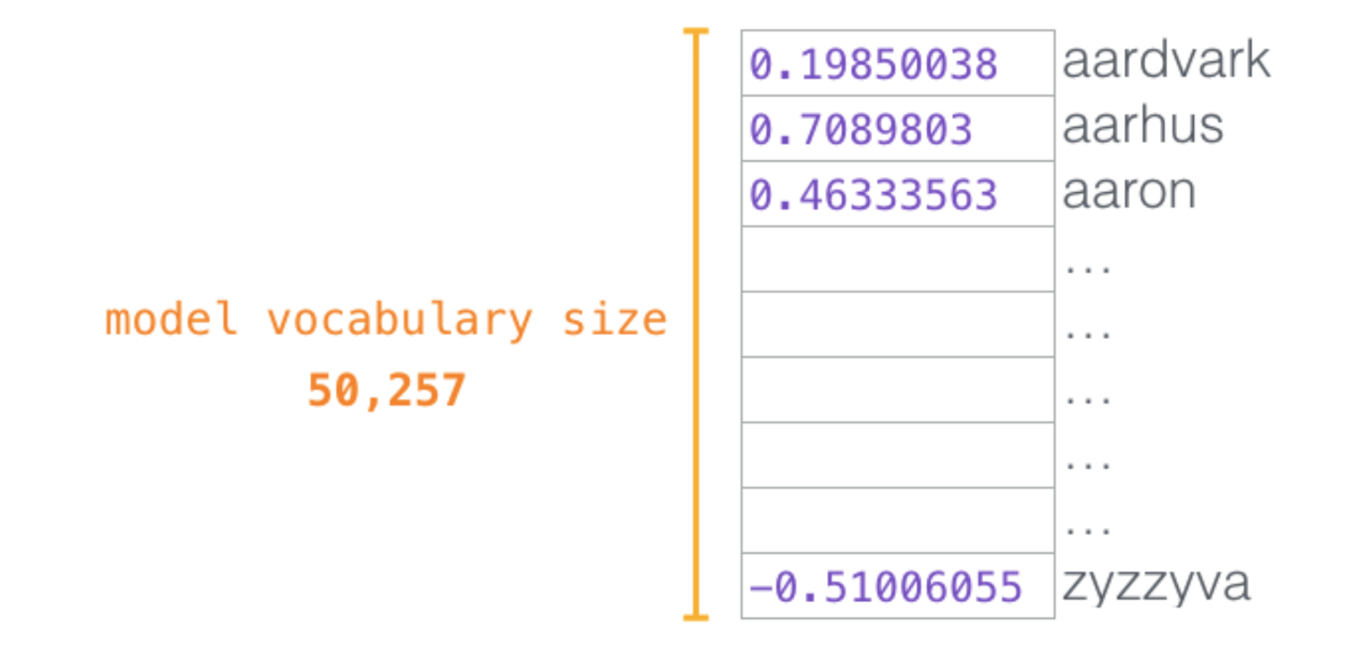
Text generation challenges
In each step we have different output is probabilities, dependent on the previous inputs

Slide 25
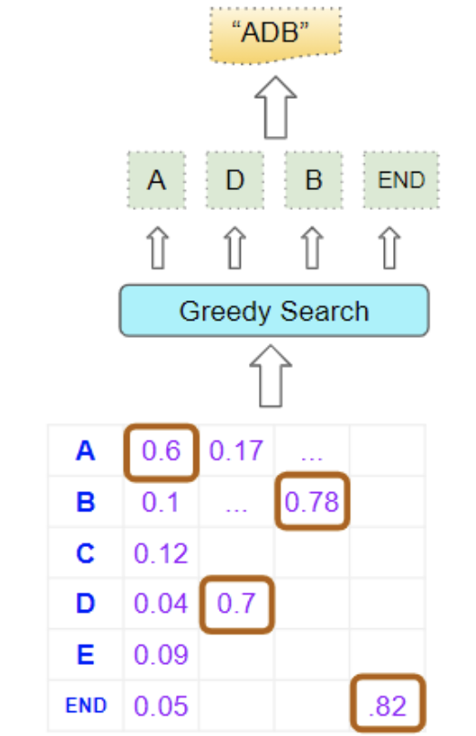
Search problem - Greedy search
short-term gains
might result in suboptimal solution

Slide 26
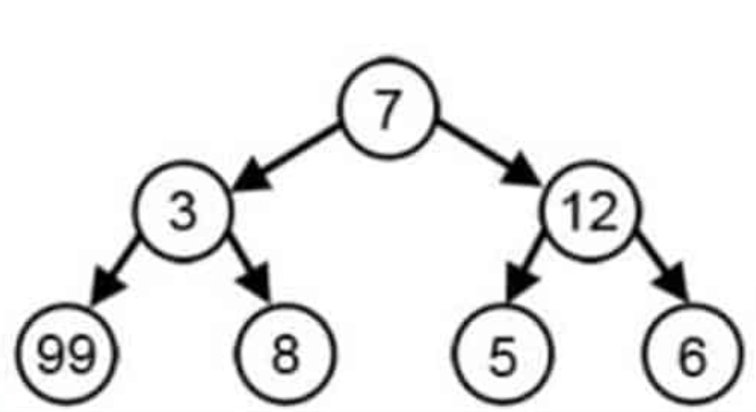
Search problem - Greedy search
short-term gains
might result in suboptimal solution

Slide 27

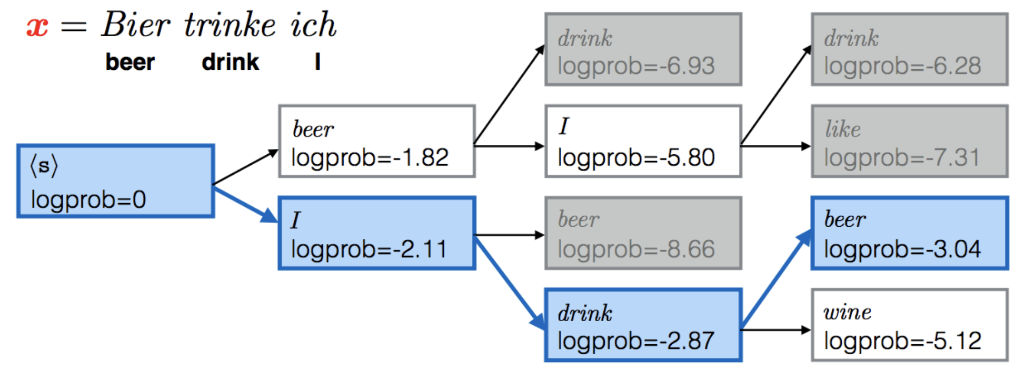
Search problem - Beam search
tradeoff - we cannot look at all the combinations
but we will look at a few at each step (beam = 2)
improves solution quality

Slide 28
Avoid loops and repeating text
repetition penalty (no_repeat_ngram_size)
all ngrams of this size can only occur once

Slide 29
Deterministic sampling methods
always pick max value - greedy/beam
an alternative sampling is the probabilistic sampling - pick a random value

Slide 30
Probabilistic sampling
Pick a token based on the output probabilities
Rare tokens will be selected rarely
How could we control this?

Slide 31
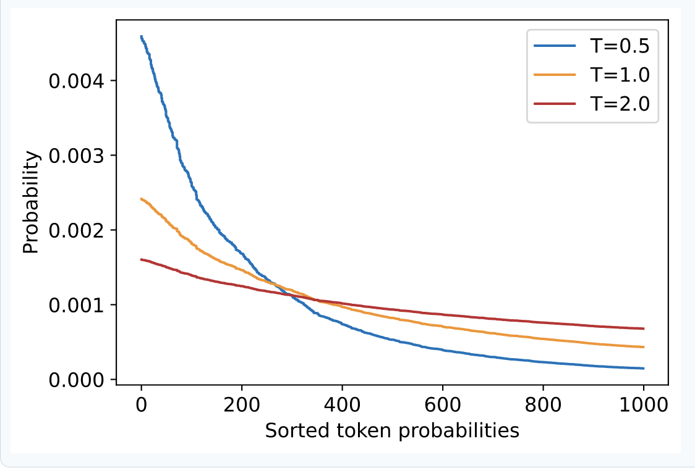
Temperature parameter
Rescale probabilities before sampling, control the shape of the distribution
T << 1 - peak for frequent tokens, suppressed rare tokens
T >> 1 - flatter distribution, rare tokens become more likely

Slide 32
Top-k or Top-p (Nucleus) sampling
Restrict the number of possible tokens
When generating long text, even low probability tokens will appear - which we might want to avoid

Slide 33
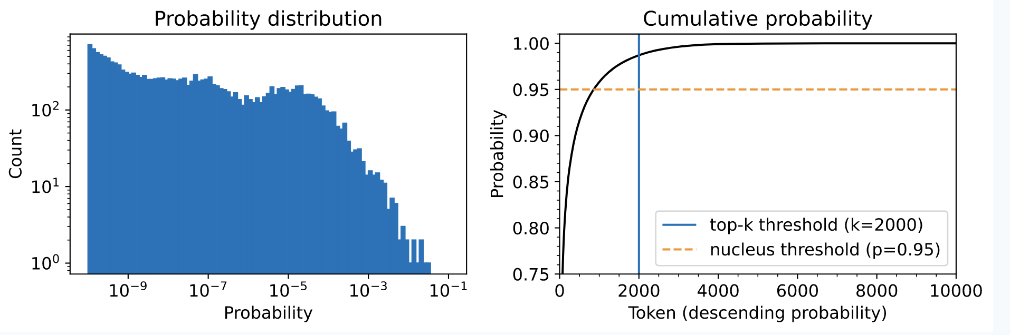
Top-k or Top-p sampling
Top-k
only choose from the k highest prob tokens, ignore bottom
Top-p
only choose from top prob tokens, which sum to p, ignore bottom %

Slide 34
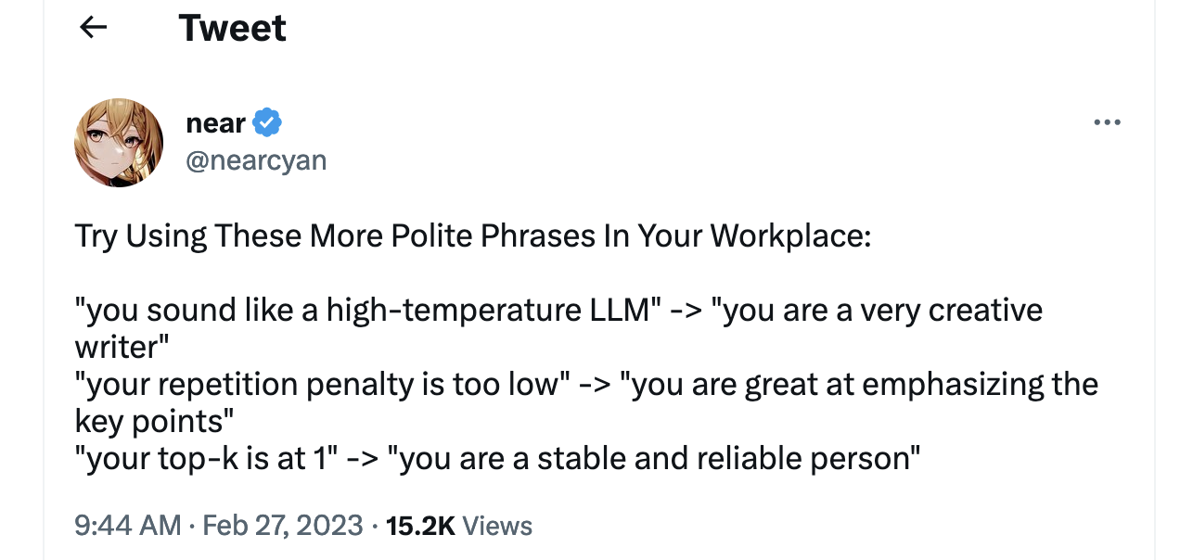

Slide 35
Text generation challenges
- probabilistic output needs to be converted to text - decoding method
- quality and diversity of the generated text depends on the choice of decoding method and parameters

Slide 36
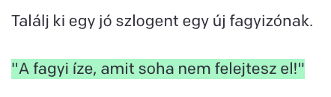
Examples - low vs high temperature

Slide 37
Examples - low vs high temperature

Slide 38
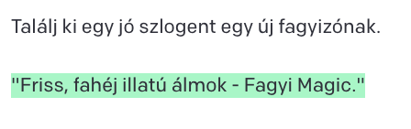
Examples - low vs high temperature

Slide 39
OpenAI breakthroughs
Scaled-up Language Models
GPT (2018) - 100 M - 40GB text
GPT2 (2019) - 1.5 B (x15) - 40TB text (x1000)
GPT3 (2020) - 175 B (x100)
Created Instruction Following Models
GTP3.5 (2022) - 175 B - fine-tuned GPT3 using RLHF
ChatGPT (2023) - further fine-tuned GTP3.5

Slide 40
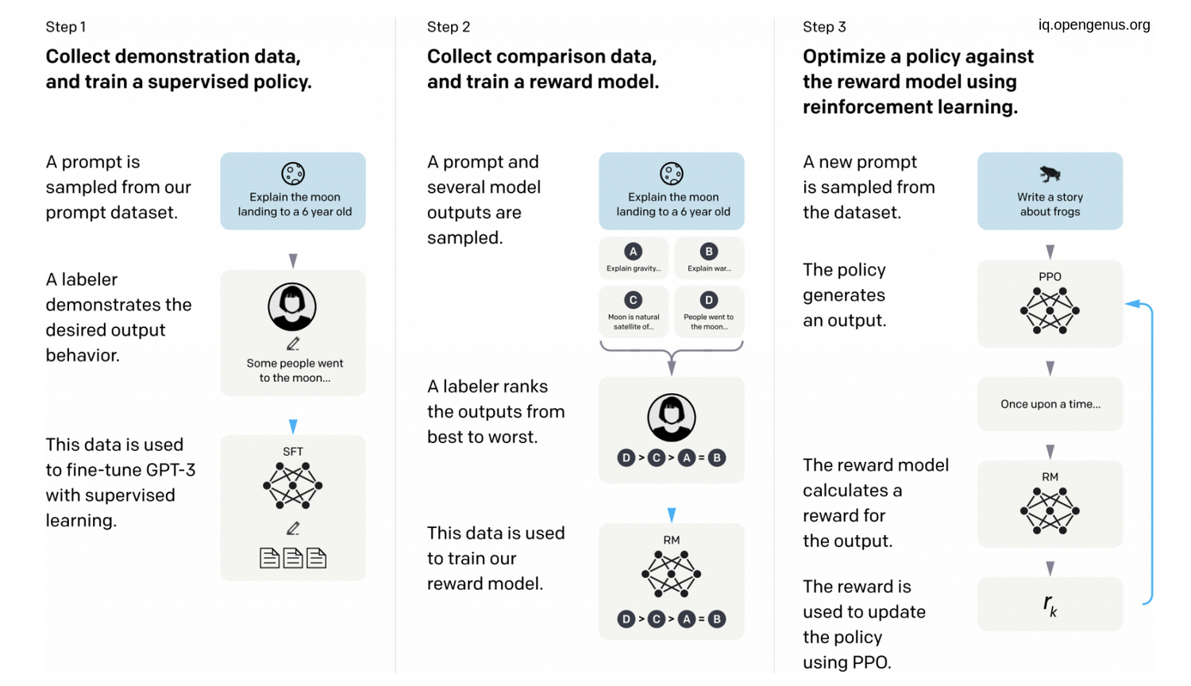
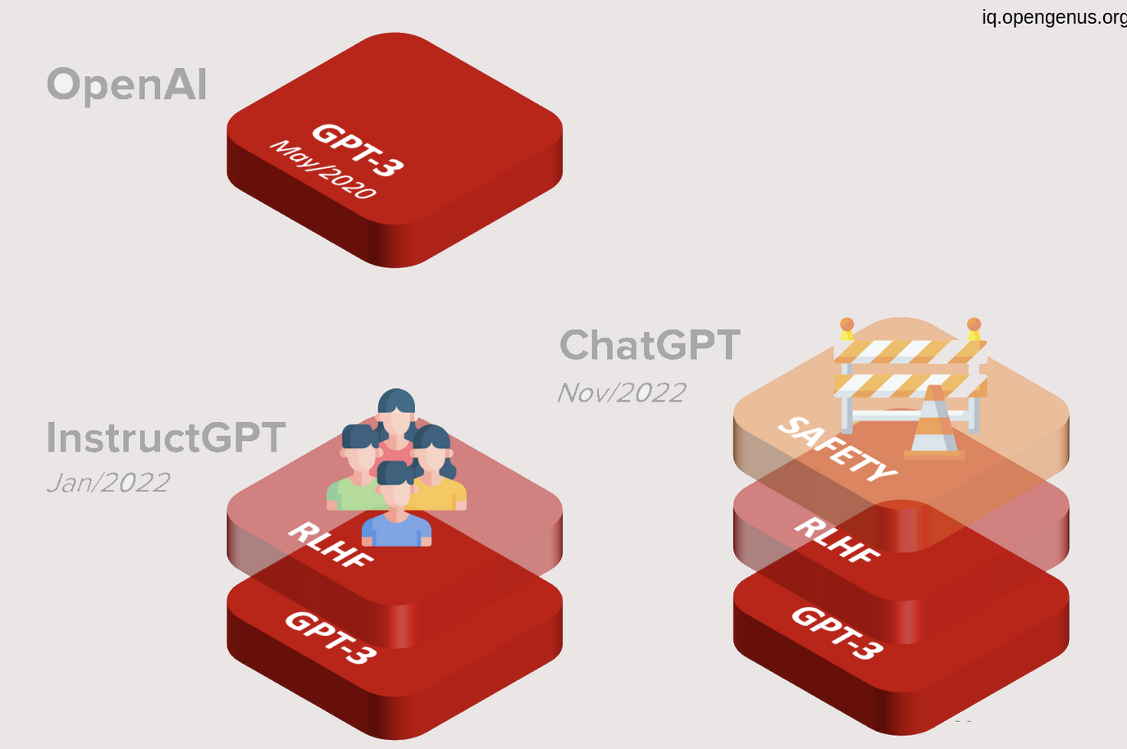
OpenAI breakthroughs

Slide 41
References
Huggingface course
How GPT3 works
Illustrated GPT2
Paperspace notebook

